Slide 1
Infopack
Pafos, Cyprus
Everything you need to know about your trip in Paphos

Slide 2
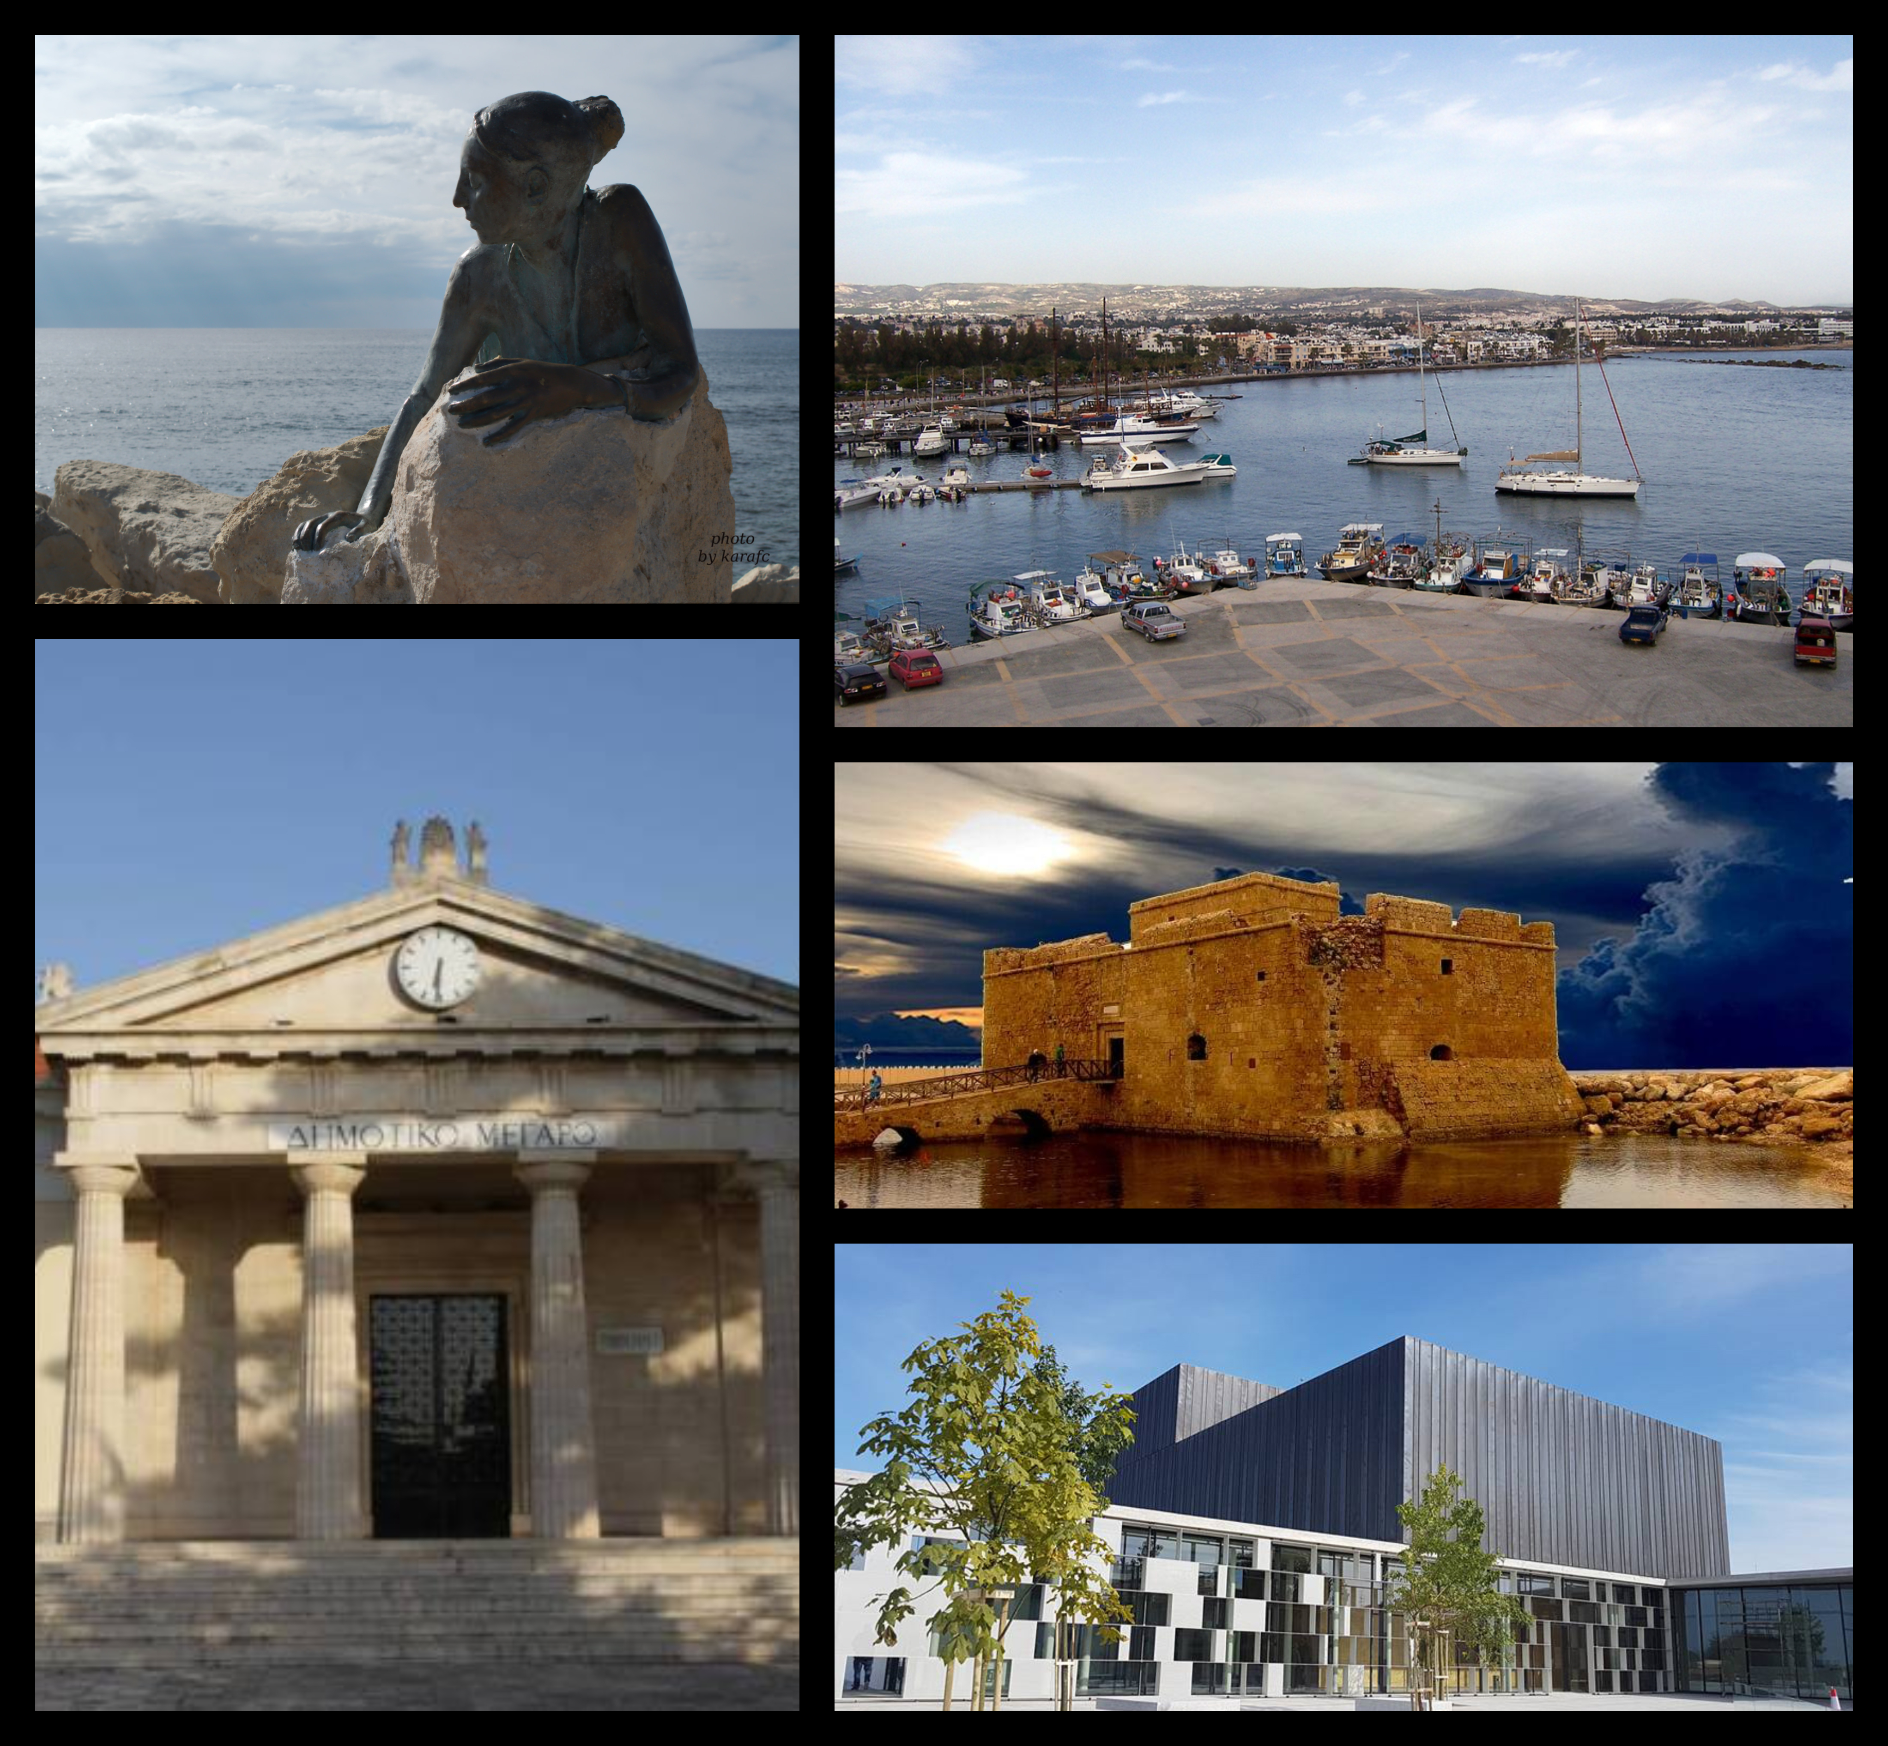
You said “Pafos”?
Pafos is located on the southwest coast of the Mediterranean island of Cyprus.
It has several sites relating to the cult of goddess Aphrodite, whose mythical birthplace was at Old Paphos (Kouklia).
Pafos is included in the official UNESCO list of cultural and natural treasures of the world's heritage for its ancient ruins and was selected as a European Capital of Culture for 2017

Slide 3
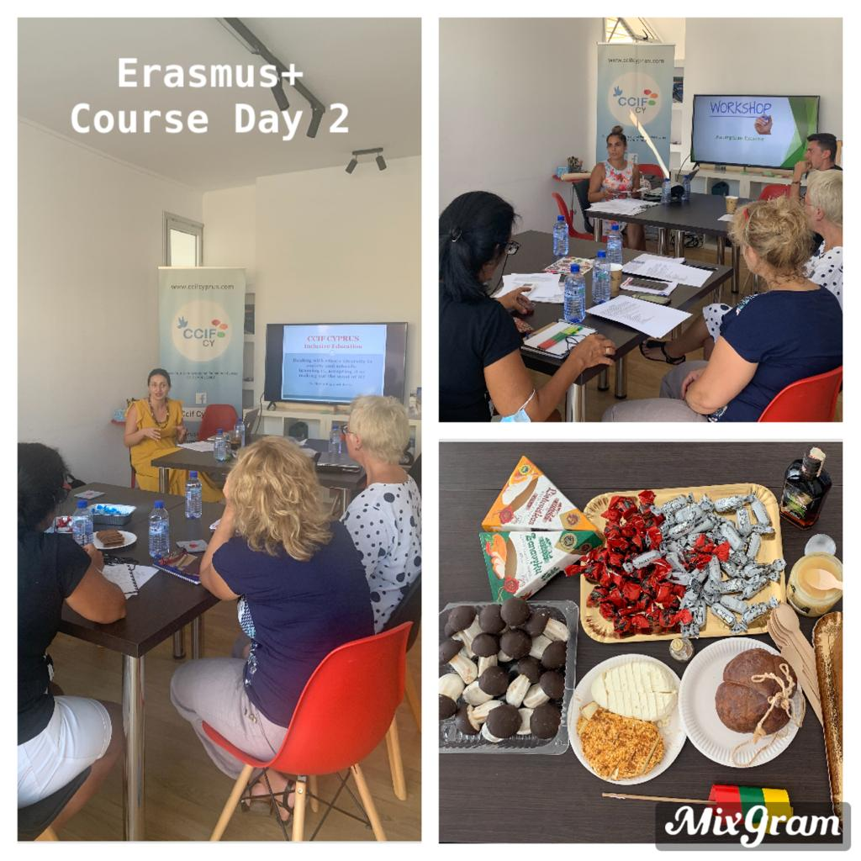
Course fees
The tuition fees cover: course material, use of the conference rooms (the course will be in different locations), use of ICT in the conference rooms and the cost of the trainers.
Course fees:
5 days course 400 € per participant
7 days course 560 € per participant
10 days course 800 € per participant
14 days course 1120 € per participant
Fees are fully covered by your Erasmus+ grant.
Traveling fares and accommodation are also covered by Erasmus+ grant.
Validation: Certificates will be given to participants with a description of the training including a description and its length.
The competences acquired can also be validated with Europass Mobility Certificates.

Slide 4
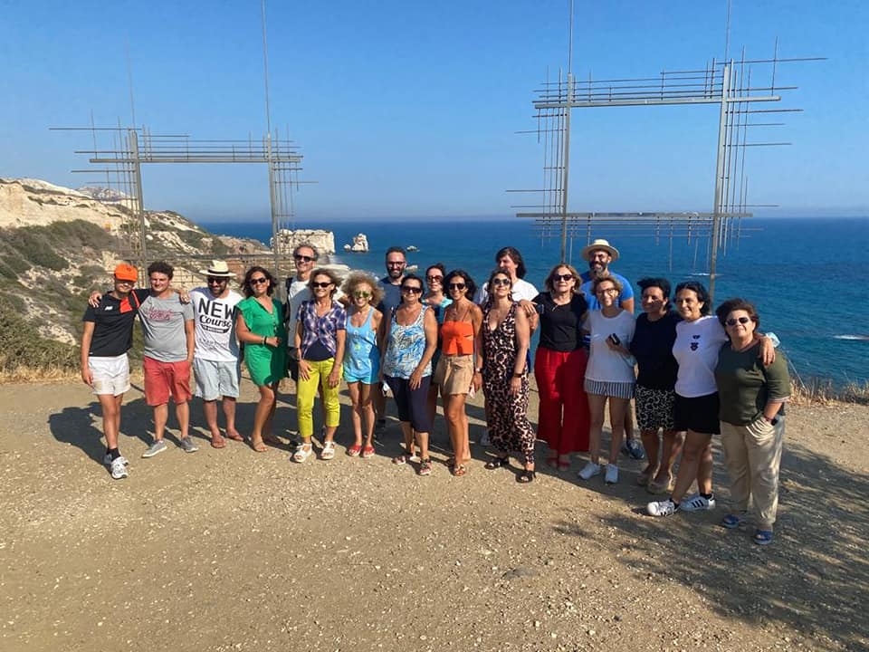
Course Fees DO NOT include - Plane tickets - Accommodation - Transfer from/to Hotel – Airports - Meals, lunches, dinners, beverages, excursions and transport during the course For FULL PACKAGE ASK for the PRICE!!

Slide 5
Full Package Single, Double or Triple Room
The full package cost covers:
5, 7, 10 or 14 days in a 4star hotel (check in after 14h00 and check out before 12h00)
Breakfast & coffee breaks with traditional snacks
Lunches (During the course)
Dinners (During the course)
Entrances in museums and archeological parc
Transport during the course to the venues, excursions, picnics, beach parties
Transfer from/to Airport – Hotel
Cypriot style dinner with traditional dishes
ON DEMAND

Slide 6
Cultural Package
Cultural package 330euro per person:
Culinary breaks
One Cypriot style dinner with traditional dishes
Entrances in museums and archeological parcs
Walking tour of harbour and Medieval Castle area Guided visit to the Archeological parc of Paphos (mosaics, house Dionysus and Theseus, ancient theatre etc
Trip to traditional village, famous for the cultural heritage
Transport for the excursions, picnics, beach party
ON DEMAND

Slide 7
Important!
Keep your tickets, boarding passes, bus tickets receipts
Don’t forget your EU health insurance card!
ACCOMODATION
REIMBURSEMENT
FOOD
HEALTH
CURRENCY
Accommodation at 4star hotel
If you have allergies or other intolerances regarding your alimentation, let us know and we’ll take care of everything!
Cyprus uses Euro currency

Slide 8
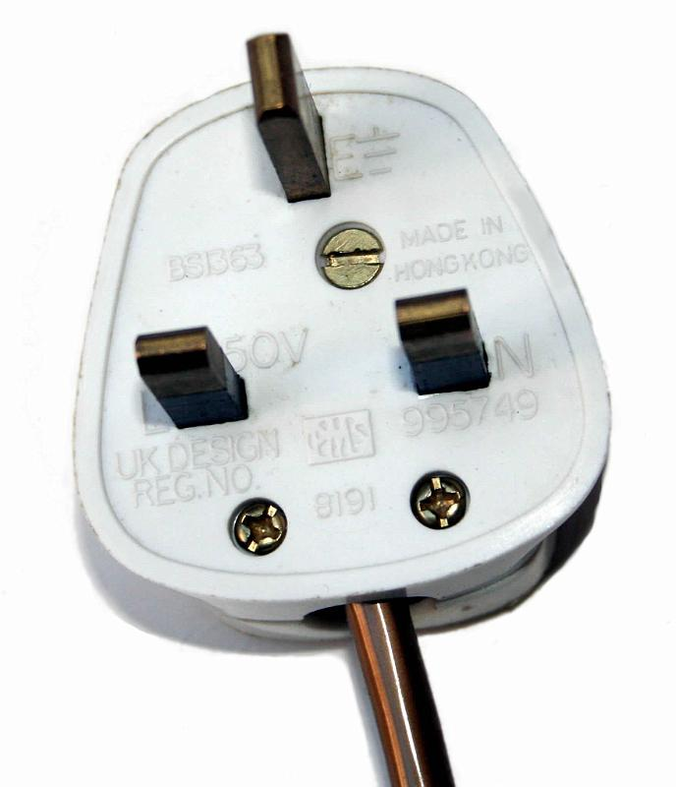
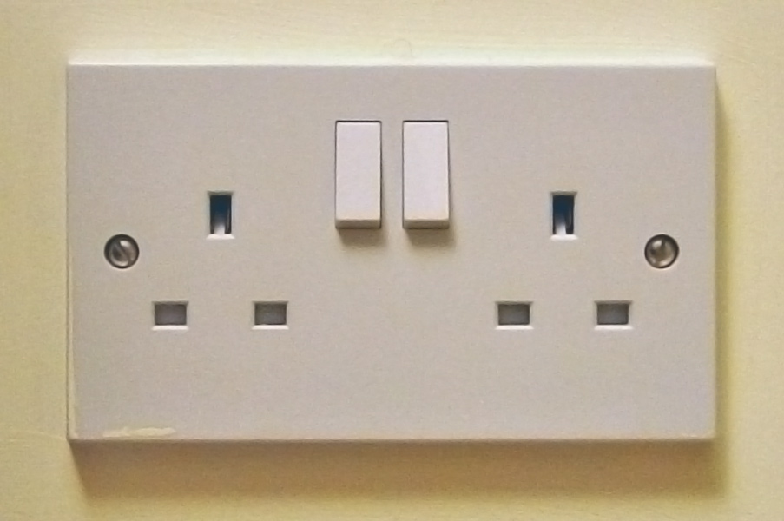
Also, don’t forget!
In Cyprus the power plugs and sockets are of type G. This type is of British origin.
So don’t forget your power plug travel adapter!

Slide 9
Your arrival in Cyprus – Guidelines from Pafos Airport or chose the full package
Stop
Timetable
At the Pafos Airport
Then, you get to Kato Pafos.
Departure from Pafos Airport to Kato Pafos
03
04
By taxi to your hotel
or
By Bus n.612 Careful! The bus station is outside the airport, just opposite the arrivals.
01
Bus tickets
You’re arrived!
You need to buy them from the bus driver. Ask for one ticket.
Let’s go for a new adventure!
02
05

Slide 10
Guidelines from Larnaca Airport or chose the full package
There are 4 options:
Option 2
Travel from Larnaca Airport to paphos Airport and then from Paphos Airport to Paphos (Less frequent, Faster)
Option 4
By taxi OR
Book with CCIF Cyprus
01
02
03
04
Option 1
Option 3
Travel from Larnaca Airport to Limassol and then Limassol to Paphos (More frequent, Slower)
For those participants/ adventurers who can drive in the English way (left side of the road!) they can rent a car

Slide 11
If you go for Option 1
Careful! The two parts of the route are done by two different bus operators, so you need to change bus at Limassol.
Total trip duration: 3 hours is an average estimate
Total cost: 15-20€ (from the Airport to Limassol and from Limassol to Paphos bus station)
Directions:
First, you get your tickets from the bus stand at the Arrival’s Area near the designated bus exit. The receptionist there will give you all the necessary information for the trip. It is also necessary to prebook. Call Kapnos Airport Shuttle at 77771477 or email info@kapnosairportshuttle.com
Approximately 15 minutes before the departure time, the bus driver will announce that you can get on the bus and he will help you with your language. The trip from Larnaca Airport to Limassol takes about 50-60 minutes.
You arrive at Agios Georgios Havouzas Church in Limassol where you will get the bus to Pafos.
There will be some waiting time at Agios Georgios Havouzas depending on the departure time of the bus.
The trip for Limassol to Pafos takes about 50 minutes.

Slide 12
Emergency Numbers
Ambulance, Fire Service and Police:
199 or 112
Find an open pharmacy at night in Cyprus:
192
Narcotics & Poisoning: 90 90 14 01
Paphos General Hospital: +357 26 80 3260

Slide 13
What are you going to do in Cyprus?
Inclusion and diversity
Digital Transformation including ICT or STEM
Environment, climate change
Demoracy in EU
B1 ENGLISH LANGUAGE
B2 ENGLISH LANGUAGE
CLIL
ICT – TEAM Work
ENTERPRENEURSHIP MINDSET
Other Courses available:
​​Inclusive Education
Educational Leadership
Conflict Management​/Effective Relationship
Social Web Solutions in classrooms
Digital/Art Tools in real or virtual museums
COURSES
https://www.ccifcyprus.com/erasmus-courses.html

Slide 14
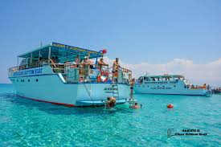
Important notes
 | Practical Part : learn by doing and workshops Evaluation of the training Optional Blue Lagoon morning cruse, jump and swim (cost will be announced if interested) The guided tours to city center, museums and archeological sites by CCIF Cyprus
 | 1. Ask for the full Package and live exceptional moments by the sea; 2. Learn the new trends in education; 3. Be the agent of change in your school;

Slide 15
Intercultural night: One of the significant parts of the course are the intercultural nights – and we love them! Participants usually bring some traditional food and beverages. Intercultural nights also aim to present your country. Be creative, it is gonna be fun!
Dissemination: Because we will create some catchy outcomes, we would like to share with others to see what we have done and created.
Please, do not forget to take these following documents:
ID or Passport
Blue health insurance card “EHIC” (if applicable)
Documents of your insurance
Signed contract and the receipt of your payment

Slide 16
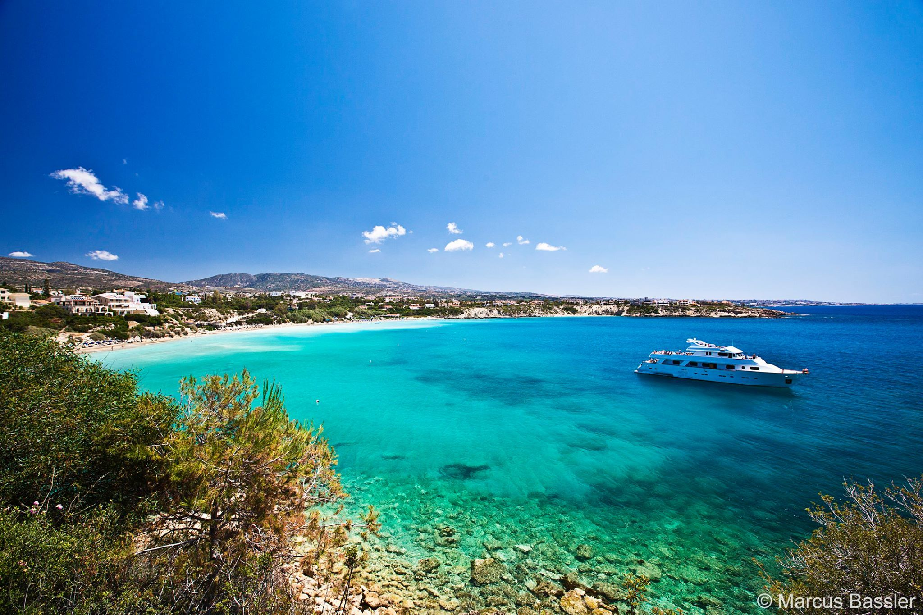
One final thing!
We have a general tip to what to bring with you to attend this event:
A beach towel and your SWIMMING SUIT!
Pafos, Coral Bay Beach

Slide 17
See you soon in Pafos !
FOR MORE INFORMATION
+35799647987
ccifcyprus@outlook.com
https://www.ccifcyprus.com/erasmus-courses.html

